Slide 1
K-Means Algorithm
By
Shyamala Mathi

Slide 2
What is K-means algorithm?
It is an unsupervised Learning Algorithm. Here, we don’t have labelled data, unlike supervised learning algorithm.
K-means is a clustering algorithm that groups similar elements or data points into a cluster. K in k-means represents no. of clusters.

Slide 3
Algorithm Steps:
Let x be the input variable and k be the no. of clusters.
Step 1: Select k random points as cluster centers called centroids.
Step 2: Assign each xi to nearest cluster by calculating its distance to each centroid.
Step 3: Find new cluster center by taking the average of the assigned points.
Step 4: Repeat step 2 and 3 until none of the cluster assignments change.

Slide 4
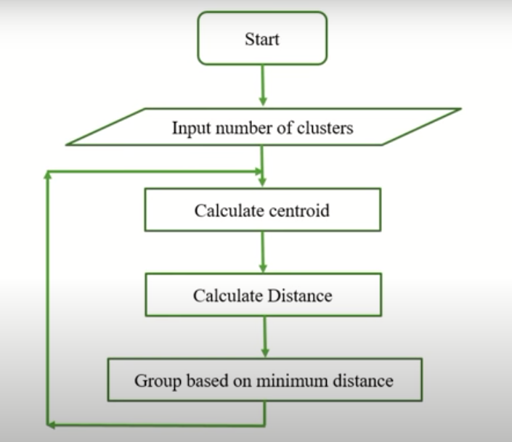
Flowchart:

Slide 5
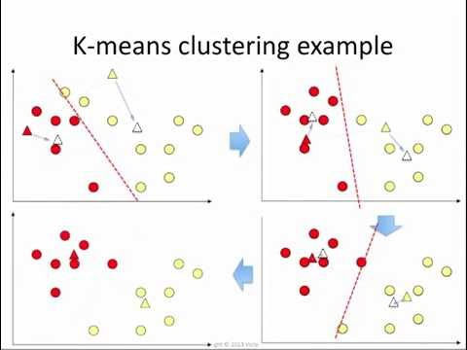
Example:

Slide 6
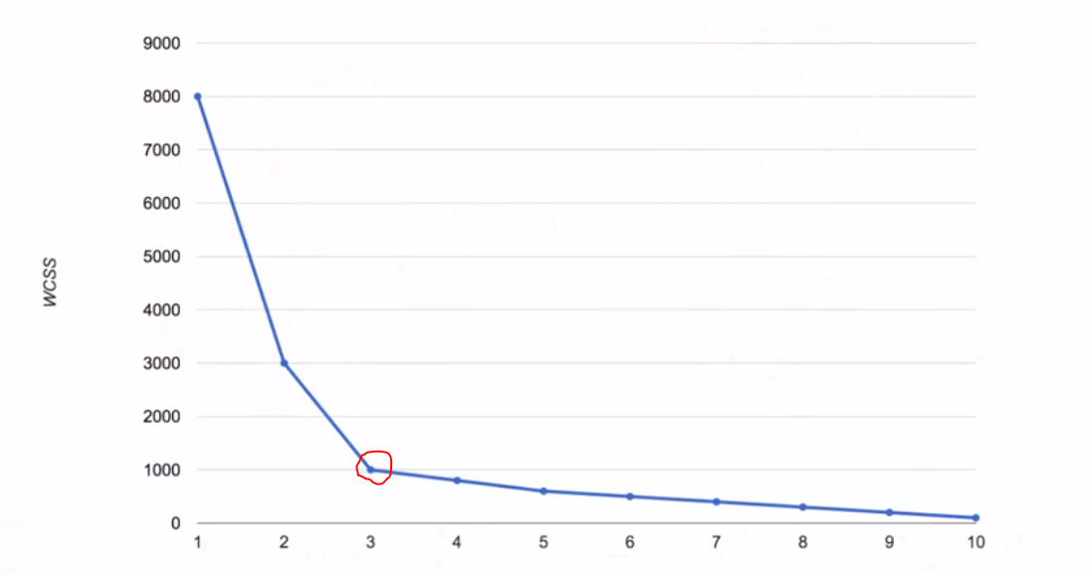
How to select the value of k.
- Elbow Method
WCSS is defined as the sum of the squared distance between each member of the cluster and its centroid.
WCSS Vs. k (no. of clusters) graph

Slide 7
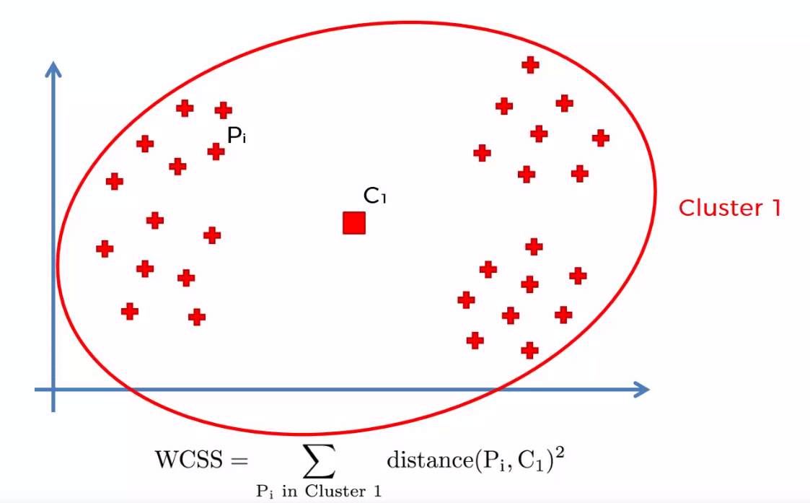
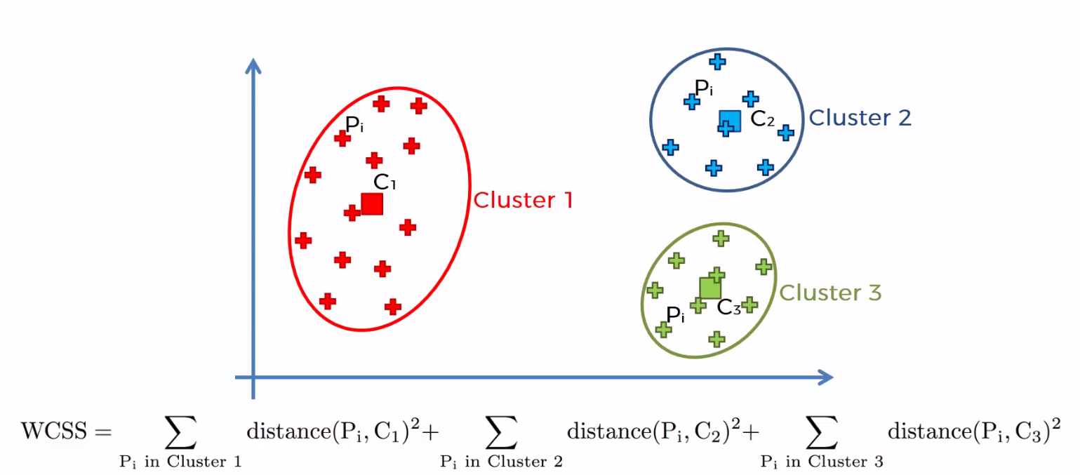
Fig 1: K=1 cluster formed
Fig 2: K=3 cluster formed

Slide 8
K-Means Advantages :
1) Relatively simple to implement.
2) Works well to large data sets.
3) Guarantees convergence.
4) Easily adapts to new examples.

Slide 9
K-Means Disadvantages :
1) Difficult to predict K-Value.
2) Different initial centroids can result in different final clusters.
3) It does not work well with clusters (in the original data) of Different size and Different density

